Slide 1

Handwritten Digit Recognition
Jotiba Yadav (61)
Venkatesh Ganeshan (56)
Rushikesh Darge (08)
Project Guide
Prof. A. D. Palsodkar

Slide 2
Introduction
Handwritten digits recognition becomes increasingly important in the modern world due to its practical applications in our daily life. In recent years, numerous recognition systems have been introduced within many applications where high classification efficiency is required.
It helps us to solve more complex problems and makes ease our tasks.

Slide 3
Abstract
In a computer vision system, handwritten digits recognition is a complex task that is central to a variety of emerging applications. It has been widely used by machine learning and computer vision researchers for implementing practical applications like computerized bank check numbers reading.

Slide 4
Research Table
Title | Name | Year | Description
Handwritten digit recognition based on depth Neural Network. | Yawei Hou, Huailin Zhao | 2017 | In order to obtain a network model with a higher recognition rate, this paper finally studies the combined depth neural network. By experimenting with the MNIST data set.
Handwritten Digit Recognition Based on Depth Neural Network | Yawei Hou Huailin Zhao | 2018 | Neural network and depth learning have been widely used in the field of image processing. In order to obtain a higher recognition rate with a simple model, the BP neural network and the convolutional neural on the MNIST data set. the optimal result is 99.55%.

Slide 5
Artificial Neural Network
An ANN is based on a collection of connected units or nodes called artificial neurons, which loosely model the neurons in a biological brain. Each connection, like the synapses in a biological brain, can transmit a signal to other neurons. An artificial neuron that receives a signal then processes it and can signal neurons connected to it.

Slide 6
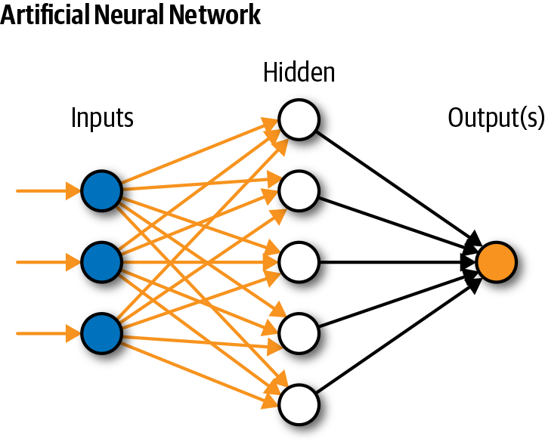

Slide 7
Approach using CNN
In Convolution Neural Network ,the convolution / fully connected layers perform transformations that are a function of the activations in the input volume. On the other hand, the pooling layers will implement a fixed function. The parameters in the convolutional layers will be trained with stochastic gradient descent algorithm so that the class scores are consistent with the labels in training set for each image.
The algorithm will prepare the trained model which will be used to classify the digits present in the test data. Thus, we can classify the digits presents in the images as: Class-0,1,2,3,4,5,6,7,8,9

Slide 8
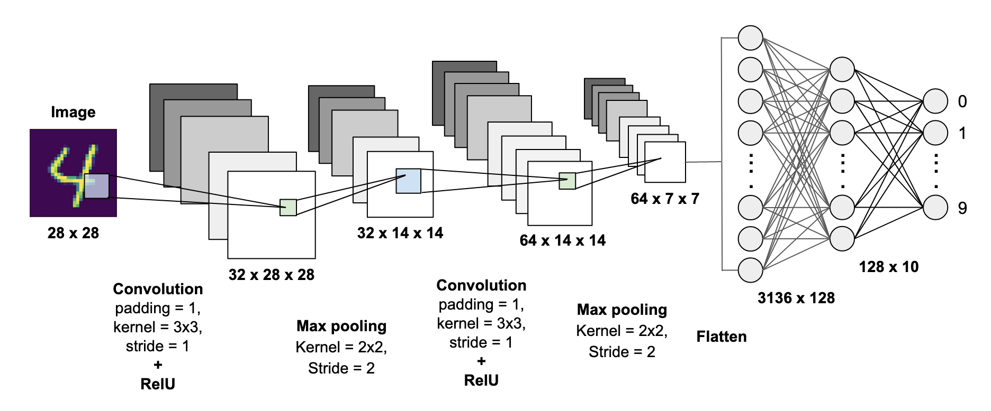
CNN

Slide 9
Dataset
The MNIST database of handwritten digits, available from this page, has a training set of 60,000 examples, and a test set of 10,000 examples. It is a subset of a larger set available from MNIST.
.It is a good database for people who want to try learning techniques and pattern recognition methods on real-world data while spending minimal efforts on preprocessing and formatting.

Slide 10
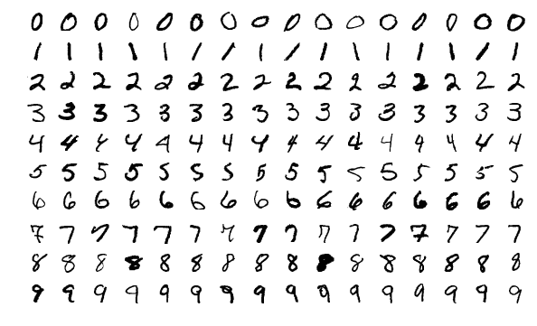
DataSet

Slide 11

DEPLOYMENT
Streamlit :
Streamlit is an open-source Python library that makes it easy to build beautiful apps for machine learning. You can easily install it via pip in your terminal and then start writing your web app in Python.

Slide 12

Flask Framework
Flask is a micro web framework written in Python. It is classified as a microframework because it does not require particular tools or libraries.
Benefits:
built-in development server and fast debugger
Basic fundamental API is nicely shaped and coherent
Highly flexible
It is easy to deploy the flask in production

Slide 13
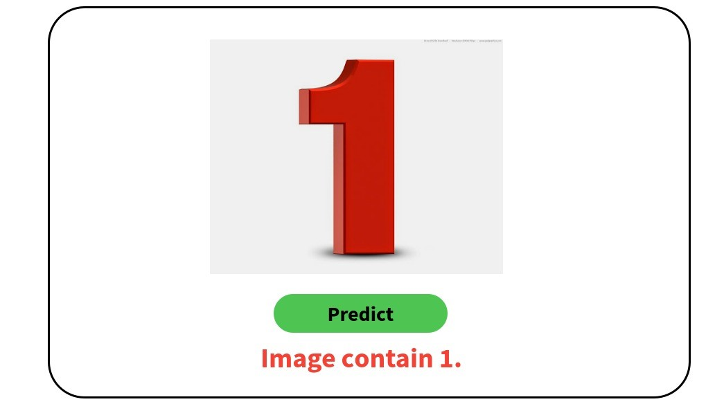
Demo

Slide 14
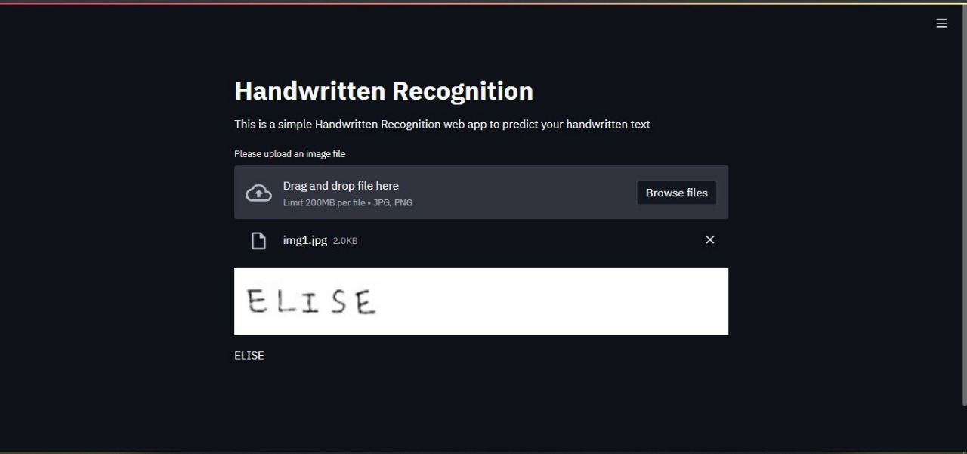
Output

Slide 15
Summary
Here we demonstrate a model which can recognize handwritten digit. Later it can be extended for character recognition and real-time person’s handwriting. Handwritten digit recognition is the first step to the vast field of Artificial Intelligence and computer Vision.

Slide 16
Thank You !!!

